Slide 1
Quality Assurance System
UOC
Planning and Quality Office
http://www.uoc.edu/portal/ca/qualitat/index.html
http://www.uoc.edu/portal/es/qualitat/index.html

Slide 2
External evaluations and accreditations

Slide 3
Evaluation AQU: Humanities and Catalan Philology 2000/01 and 2002/03 Documentation
Evaluation EFQM (2004)
Assessing EUA (2005)
Evaluation of the Library by AQU 2005/06 (http://www.aqu.cat/universitats/abanseees/serveis_bibliotecaris_en.html#.VSuCmtzkfeI)
AQU Institutional Assessment and evaluation in 2006/07 the following qualifications: Psychology, Law, Science and Public Administration , and in 2007/08 the following qualifications: ET Computer Software, Computer Systems, Computer Engineering, Business, Market Research and Techniques (http://www.aqu.cat/universitats/abanseees/virtual_en.html#.VSuCwdzkfeI)
Certification Systems Manual Internal Quality Assurance, under the model AUDIT AQU in 2007 and 2009 (http://www.aqu.cat/universitats/audit/proces_en.html#.VSuCa9zkfeI)
Certification Manual Evaluation of the teaching, the teaching model under AQU in 2008 (http://www.aqu.cat/professorat/merits_docencia/mad_en.html#.VSuCSdzkfeI)
Institutional Evaluation by the OECD in 2010 (http://www.oecd.org/edu/imhe/QT%20policies%20and%20practices.pdf)
Certification Euro-inf by EQANIE-European Quality Assurance Network for Informatics Education in 2012
Evaluation of Tourism Degree and Master Degree in Sustainable Tourist Destination Strategy and Management in 2014 by UNWTO (http://themis.unwto.org/content/unwtotedqual)
External accreditation by UOC the following programs: Law, Criminology, Taxation, Political analysis, Computer Engineering, Telecommunication technologies, Multimedia and Multimedia applications 2014. (http://www.aqu.cat/universitats/acreditacio/index_en.html#a2)

Slide 4
Levels of quality
INSTITUTIONAL
Internal quality assurance system
External Validation
Internal/External Monitoring
External Modification
External Accreditation
PROGRAMMES
TEACHING STAFF
TEACHING
Internal quality teaching
RESEARCH
External application

Slide 5
Internal Quality System
The Quality Agency in Catalonia (AQU), created the AUDIT program in 2007: the evaluation programme, the objectives of which are as follows:
To promote the development and implementation of internal quality assurance systems in education in universities and other higher education institutions through the integration of all the activities associated with the quality assurance of degree programs that have already been undertaken and by ensuring that an internal quality assurance system is used for program monitoring.
To implement a program that leads to the recognition of the design of internal quality assurance systems through the evaluation of their adequacy and the subsequent certification of those that have been implemented.
Design of the training pogram and training processes
Decision making and implementation of improvement actions
Program development and implementation processes
Interest Groups
Results, monitoring and evaluation
Public information

Slide 6
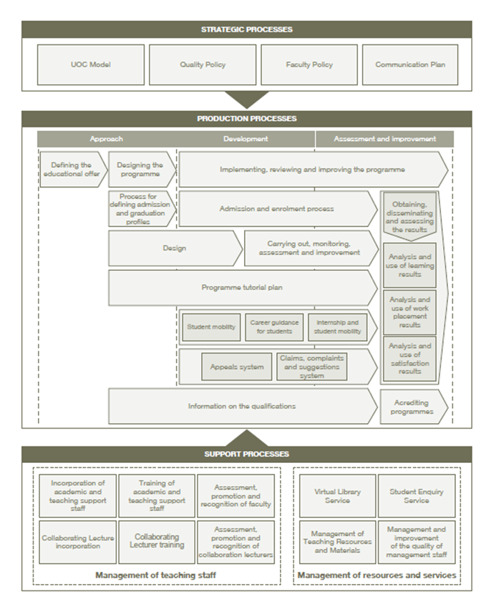
Strategic Processes
Production or Operational Processes
Support Processes
http://www.uoc.edu/portal/ca/qualitat/documentacio/UOC_Manual_sistema_garantia_Cat_04-1.pdf

Slide 7
PROGRAMMES: Framework for the verification, monitoring and Accreditation
4 years Postgraduate
6 years Undergraduate
Modification
Ex-ante
evaluation
Post-ante
evaluation
Deployment
1. Description
2. Justification
3. Competences
4. Admission and requirements
5. Degree chart and coursework
6. Faculty and staff
7. Services and resources
8. Expected results
9. Internal Quality System
10. Implementation Schedule
Monitoring and
External Evaluation
Implementation
Review and
improvement
Processes
Results
Monitoring Indicators
Monitoring Public Information
Monitoring Quality System
Tracking Qualifications
Review
Improvement plans
Public information

Slide 8
TEACHING STAFF: Teaching and research processes
The Quality Agency in Catalonia (AQU), created the DOCENTIA programme in 2007 in order to provide a framework , a model and procedures for universities, to set the assesment of the teaching merits of teaching staff. Merits in teaching are evaluated to five-year period.
Merits in research are assessed by the Quality Agency. Each university is informed of the positive assessments of its candidates. Merits in research are evaluated to six-year period.
http://www.aqu.cat/professorat/merits_recerca/universitats_privades_en.html#.VSuLp9zkfeI

Slide 9
Projects that support the improvement of quality at the UOC (2010-2015)

Slide 10
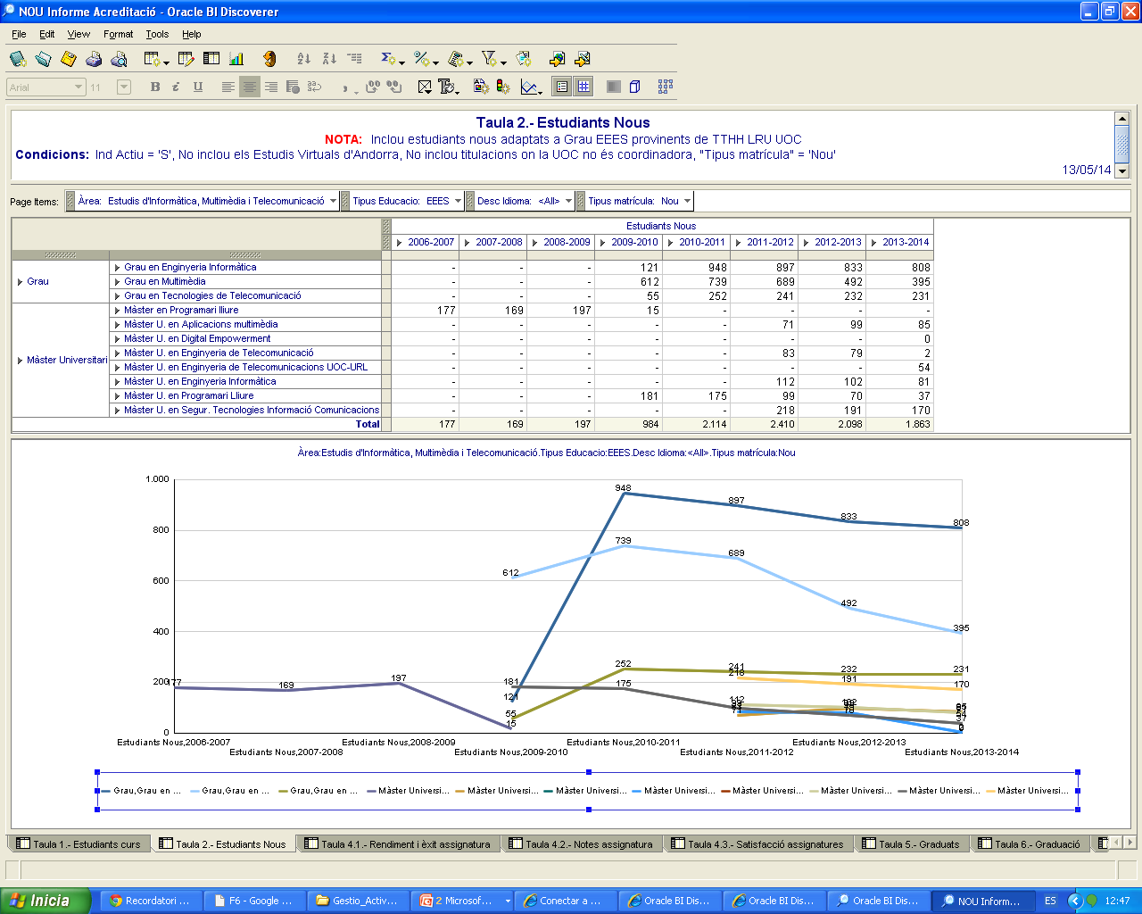
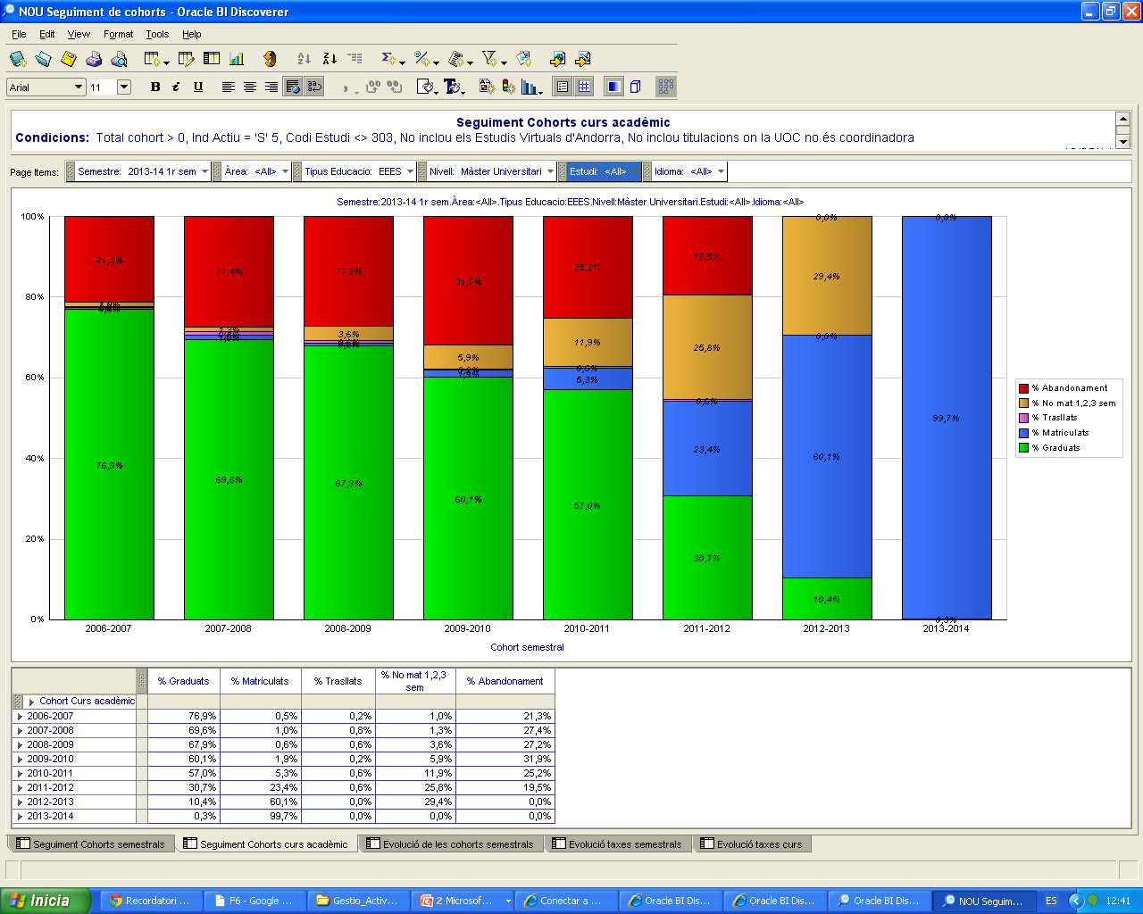
The following projects are designed accordind the internal quality assurance system:
DAU – Universitary datawarehouse: open to the teaching staff offers the academic and the satisfaction results for classroom, subject, programme and institutional lebel. Is used at the monitoring and accreditation process and the results are used for the teaching evaluation.

Slide 11
SURVEY SERVICE – Internal service for the collection, analysis and disseminate the views of the different interest groups. For students, UOC collect information at diferent moments related to the lifecycle of students:
Access
Academic period
Graduation
Post graduation
Assessment of joining the university:
Summary of expectations with the training and evaluation of satisfaction with care and shelter.
Assessment of subjects studied:
Compilation of satisfaction towards the course, the teaching, learning resources and assessment system.
Practicum
Evaluation of end of year:
Compilation of satisfaction toward the degree, tutoring, Services and global institution.
Assessment of graduates over time:
Summary descriptive data such as the motivations, expectations, assessment and links with the UOC.
Assessment of the training program towards professional and personal development:
Every 3 years. Such surveys include the satisfaction of the student model to professional education courses taken at the UOC. Also the employer to measure the extent to which training has satisfied market demands.
Final Project

Slide 12
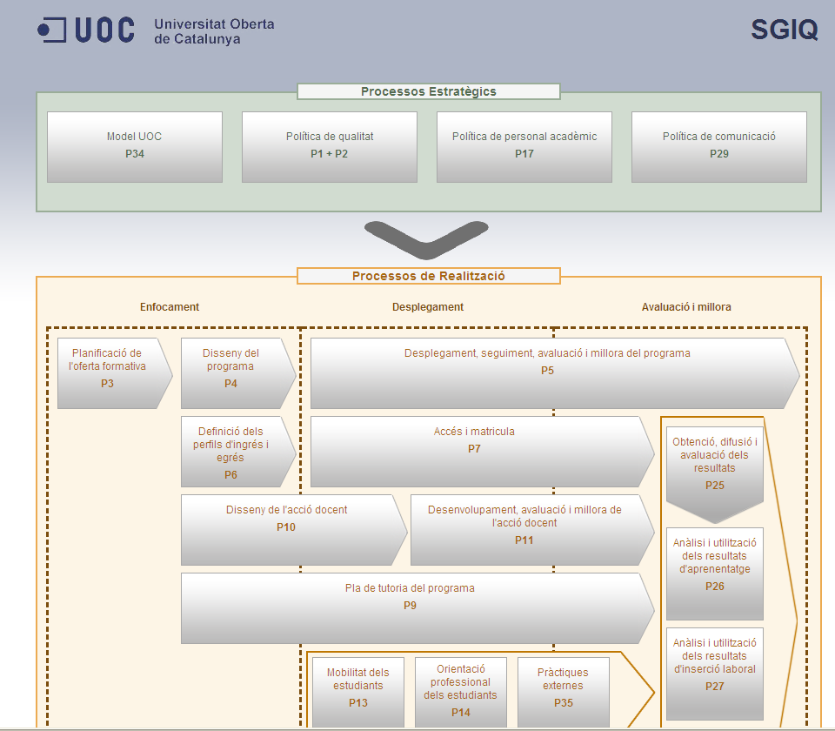
SURVEY graduate (2007, 2011 and 2014) by the AQU : The aim of this project is known, among other things, time, quality and pathways of their insertion, and also to know your level of satisfaction regarding the training received. This study is set for all Catalan universities.
For 2014, the reference population for the survey totals 51,743 people, with the anticipated sample being 27,848 people. Results are opened to the society.
http://www.aqu.cat/estudis/ilaboral_2014_en.html#.VSuQOtzkfeI
DOCUMENTA – This is a digital document that allows a good classification and retrieval to ensure good management of documents related to the design, implementation, evaluation and accreditation of degrees.

Slide 13
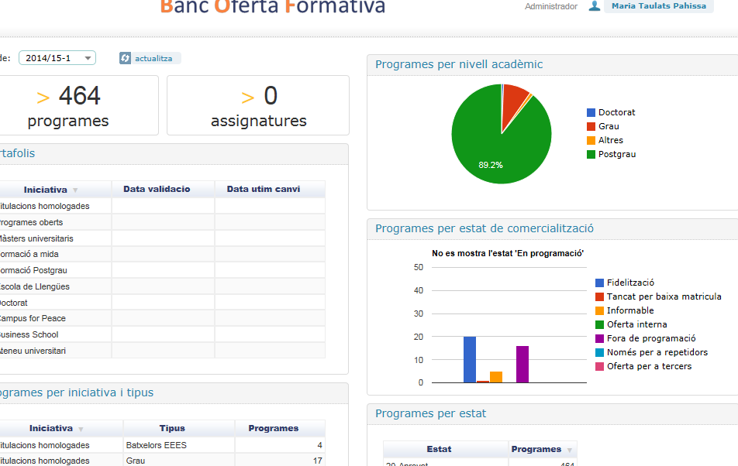
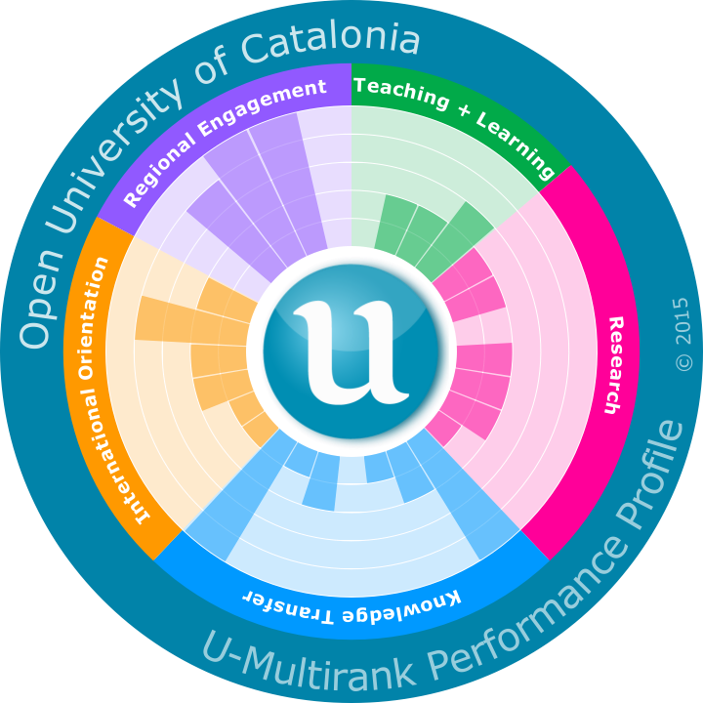
BOF (Bank of trainning) - Contains all the programs offered at the UOC with all basic features to start the process of design and implementation
U-Multirank – Through the Fundación CYD in Spain, UOC participate at the U-Multirank, 2014 was the first edition

Slide 14

THANK YOU!
qualitat_uoc@uoc.edu
mtaulats@uoc.edu

